Slide 1

The OSS Crew
Chengkai Yang
Christopher Wong
Hrishikesh Panchbhai
Jayalakshmi Vaidayanathan
Vishal Reddy Gopu

Slide 2
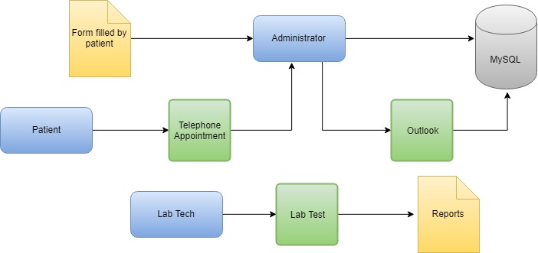

Our Business
Our vision is to make health management easier and faster for patients by connecting them with doctors and pharmacies
The compassionate care provided by our doctors, nurses and other staff is a key to our success.
Our expertise covers all specialties, from cancer to women's health.
Risk and Mitigations Healthify is recognized for its advanced patient care and technology.

Slide 3
Business requirement
The new system will provide below mentioned features:
360- degree profile view
Provide doctors with accurate past medical records of patients to provide better diagnosis and treatment
Online Lab test result Management
Provide online facilities for patients and doctors to access the patient’s lab test results online
Virtual appointment
Scheduling an appointment for a skype visit. Conversing on a private chat with Doctor/Patients
Connecting Pharmacy
A common platform to connect patients to pharmaceuticals to help patients get their medicines hassle free

Slide 4
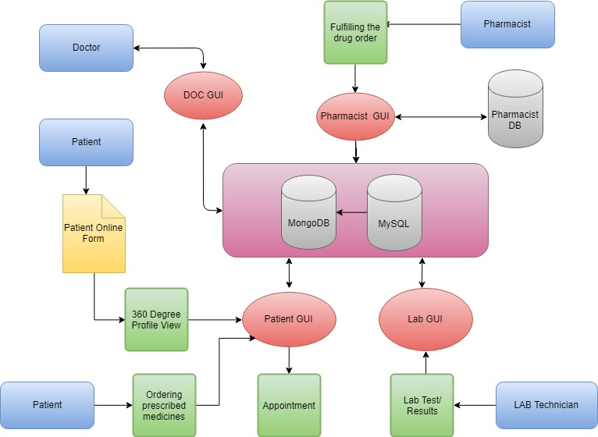
Proposed System

Slide 5
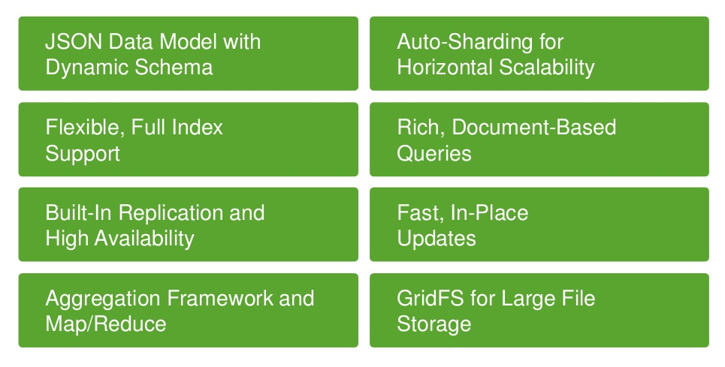
Why MongoDB?
Always-On Global Deployments
Scalability and Performance
Flexible Data Model

Slide 6
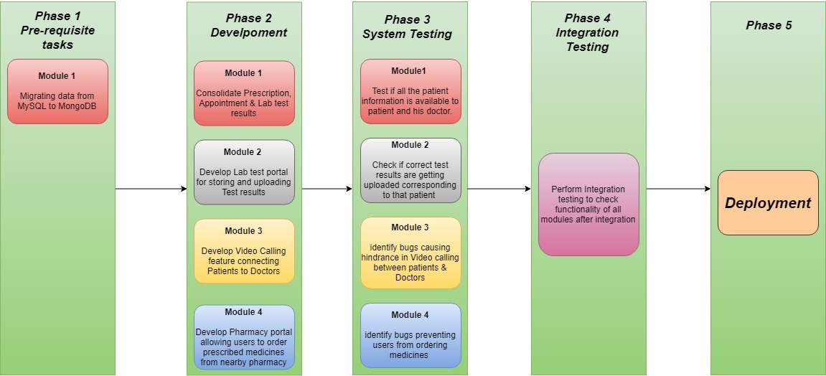
Deployment

Slide 7

Company Roadmap
Phase 4:
Deploy the System to users
(June’18)
Phase 3:
Integrate all components and perform overall testing
(May’18-June’18)
Phase 2:
Begin Development of all components in Parallel
(April’18-May’18)
Phase 1:
Requirement
Gathering & Analysis
(April’18)
https://www.google.com/search?q=company+roadmap&source=lnms&tbm=isch&sa=X&ved=0ahUKEwjgnbPz4bbbAhUFFHwKHVpQBvwQ_AUICigB&biw=1707&bih=735#imgdii=LjfEP0OQqssCUM:&imgrc=it4x1X-_AOvFXM:

Slide 8
Benefits
Increase patients served with convenient service, increase net profits
Improve internal workflow and consistent service
Improve stability and security with standardized and secure servers
At Healthify, our vision is to make health management easier and faster for patients by connecting them with doctors and pharmacies.
With our plan, we will create a modern and convenient system for patients, employees, and pharmaceutical partners.
With our new system, we will ensure more patients have access to the most advanced healthcare system available.

